Slide 1
EDA CASE STUDY SUBMISSION
Names:
Indranil Datta
Goutam Dutta
Vivek Kumar
Debanjan Chakraborty

Slide 2
Exploratory Loan Analysis
Business Objective
Identify risky loan applicants.
Reduce credit loss by avoiding lending loan to possible defaulters.
Identify the patterns of risky loan which can be resulted into rejecting a loan application, reducing lending amount or increasing interest rate.
Business Goals
Understand customer attributes and loan attributes which has influence on granting loan.
Find out driving factors that facilitate in providing loan to an applicant.
Understand risks in terms of
likely to repay the loan
not likely to repay the loan

Slide 3
CRISP-DM Framework
Data Loading
Data Cleaning
Data Transformation
Loan Information
Load data source
Filter out irrelevant columns
Transforming data to relevant numeric values
Impute necessary missing columns
Data Filtering
Univariate Data Analysis
Final Data frame for Risk analysis
Analysis by Income category
Understanding the Business Operative
Understanding the Bad Loans
Loan Issued by Regions
Types of Loan
Univariate Analysis
Bivariate Analysis
Business Risk
Credit Score
Determination of Bad Loans
Defaulted Loans
Compute correlation
Correlation Heat map

Slide 4
Identify Risky Loan Applicant
Loan Data Analysis
Reduce Credit loss
Sub Objective
Find Bad Loans
Find Regions where Bad Loans given
Find the interest rate vs loan amount for the bad loans for the region
Sub Objective
Find Bad loan given in the past years
Find the region where annual income is greater
Find which region has no or less defaulters.
Find out credit score, interest rate, employment status of the regions.
Find out the trends for interest rate and lending capacity.
Identify Pattern of Risky Loan
Sub Objective
Factors for loan is bad or not
Factors increased the risk

Slide 5
Solution Approach
Load Data
Read data and include relevant columns
Clean Data
Transform and encode data
Missing value imputation
Data cleansing
Derive Metric Data
Region wise Loan
Interest wise loan
Split and move target variable to different data frame
Bivariate Analysis on the following
Loan amount
Total amount funded by investors
Length of employment
Annual income
Home ownership
Grade
Term
Last Payment Amount
Number of derogatory public records
Interest Rate on the loan
The number of open credit lines
The total number of credit lines
Loan status
Prediction
Univariate Analysis on the following category
Categorical Analysis
Loan status
Home ownership
Delinquency label
Numeric Analysis
Term – No of payments made on the loan
Length of employment

Slide 6
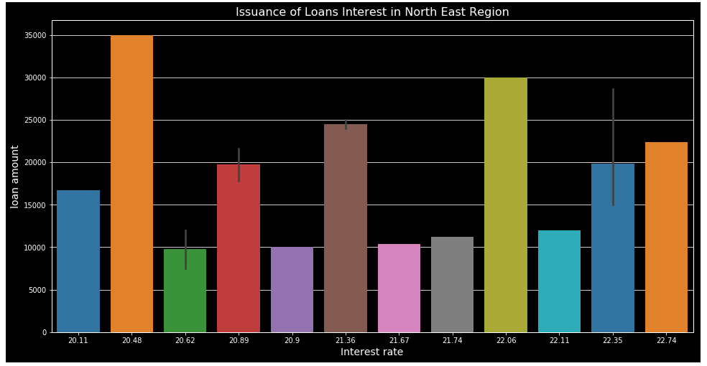
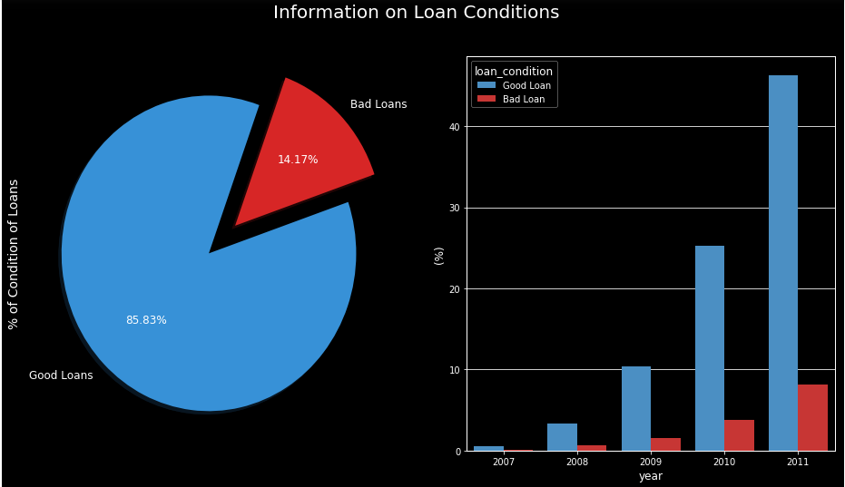
Categorical Analysis
Loan Status has three variables - Charged Off [ Bad Loan] ,Fully Paid [ Good Loan] , Current
In last 2 years 81.17% people are not defaulters. Only 16% are defaulters.
West region of US has the highest defaulters
For $35000 interest rate for North East Region where we can see highest interest rate is 20.48%
For $22400 interest rate for North East Region is maximum 22.74%
Income Category [High, Medium, Low]
High category takes more loan with high interest.
Low income category takes less amount loan and less defaulters.
Credit Score Category
People with Low credit score pays high interest.
People with High credit score are growing.
B category credit score people are more likely to be good loan takers.
Interest rate trend
Average interest rate is growing in general.
For bad credit score, the interest rate is growing faster.

Slide 7
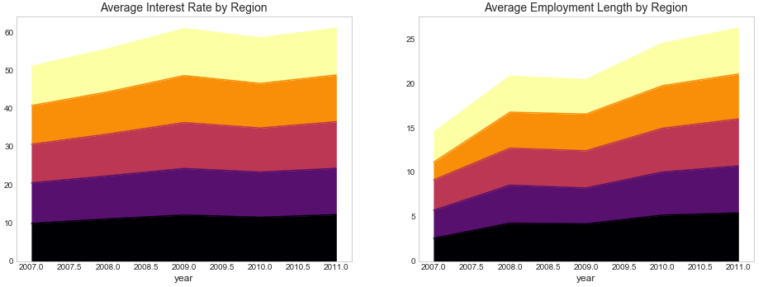
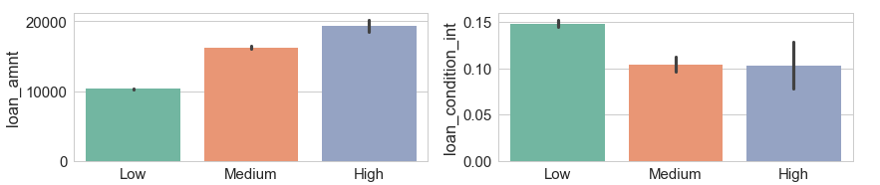
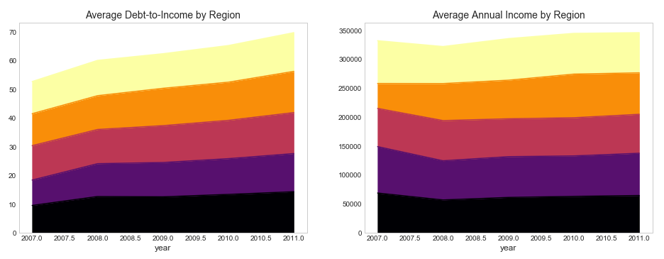
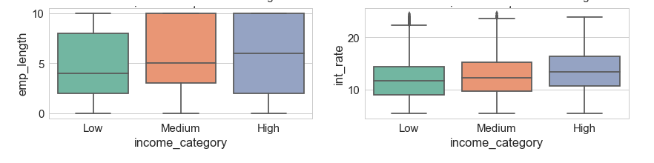
Categorical Analysis

Slide 8
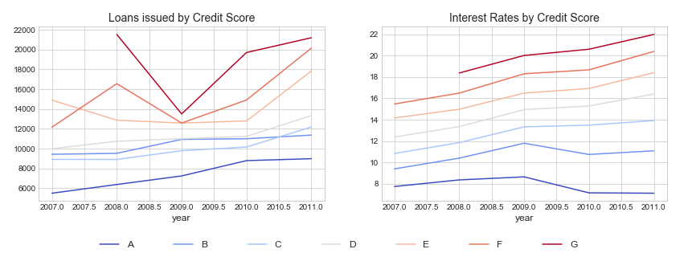
Reduce Credit Loss Analysis
West, South East and South West regions are more loan centric
Reason
In these regions the following good loan attributes are more
Average Interest
Average Employment strength
Average debt-to-income
Average annual income
These attributes increases credit score grade.
CA, NY, TX states have very good annual income.

Slide 9
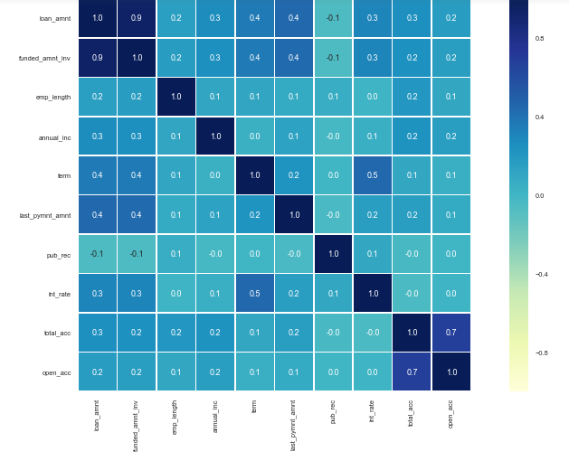
Bivariate Analysis
Total Payment, Total Payment received by Investor, Total Received Principal amounts vary together.
Loan Amount, Investor Loan Amount , Funded amount vary together as well.
Annual Income and interest rate varies inversely or are inversely proportional.
Total Payment and annual income varies together.
Loan Amount and employee strength are also very closely

Slide 10
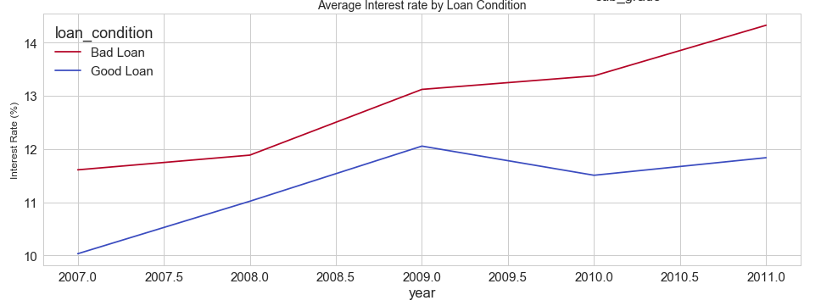
Risk Assessment Summary
Bad Loans: Most of the loan statuses belonging to this group pay a interest ranging from 13% - 14%.
Good Loans: Most of the loan statuses belonging to this group pay interest ranging from 11% - 12%.
Grade B , Sub grade B3, B4, B5 more likely to repay loans.
Most of the good loans are used for purchasing the car.
Most of the bad loans purpose are from credit purpose and small business
Most of the defaulters are having home mortgage or rented
Loan Attributes are
Loan amount
Interest rate
Invested amount
Annual Income
term
Consumer Attributes are
Credit score,
Employment years
Annual Income
Grade/ credit score
Region
Loan status

Slide 11
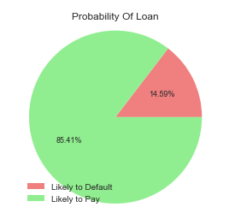
Prediction
By plotting the data of loan status i.e. loan repaid by the borrowers and loans defaulted by the borrowers and applying the logic on the top of the current data it has come out as that there are 85.5% of chances that the loans will be repaid and 14.5 % chances that loans will not be paid.
By looking into the data we can say that 6 out of 7 loans are paid
Need to come up with good benchmark so that risk of loosing money should be reduced
Conservative approach is loosing money in 1 in 7
Aggressive approach is increasing risk > 14.5 %
To become more profitable decrease the risk < 14.5 %

